Slide 1



VOIS Innovation
Marathon 2.0

Slide 2
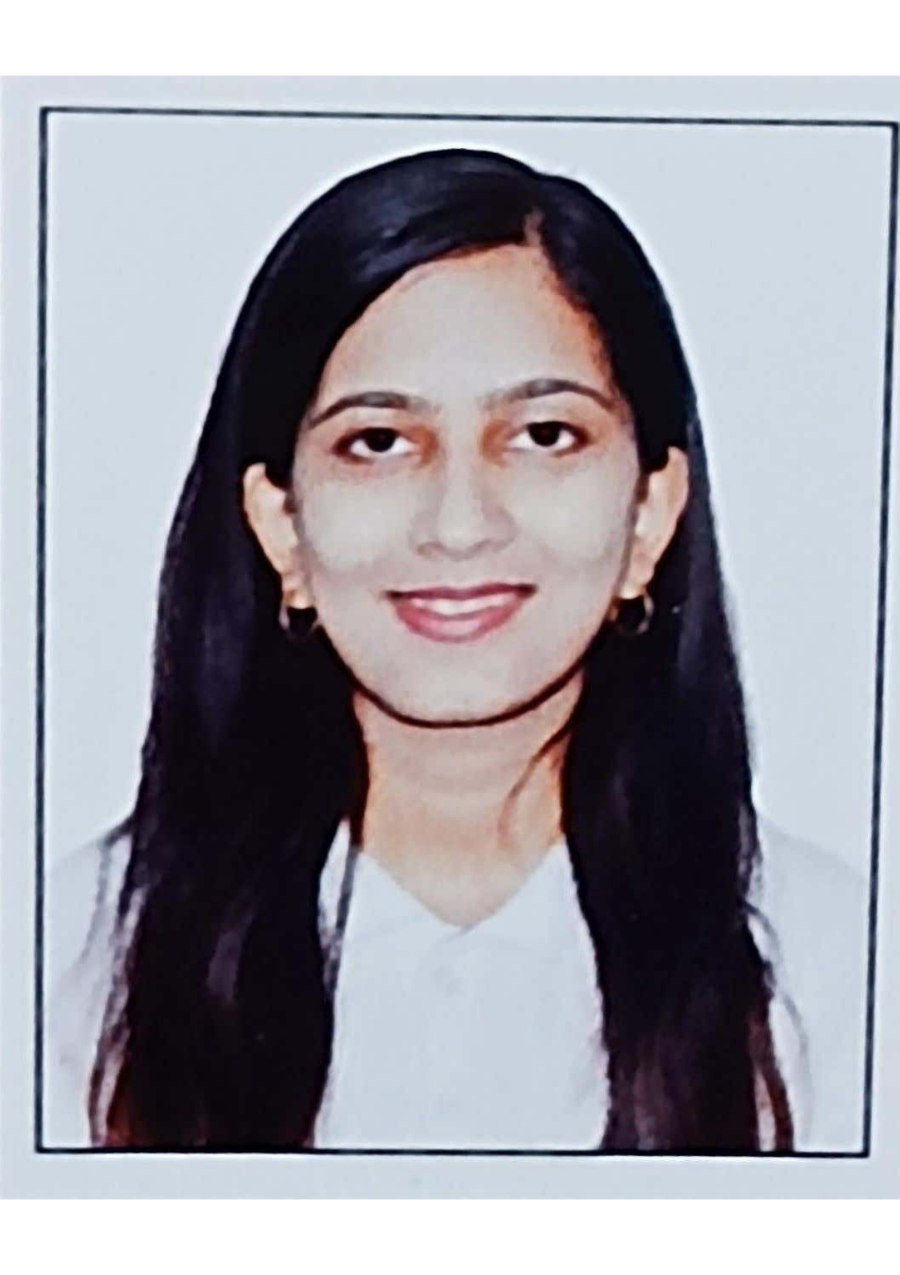

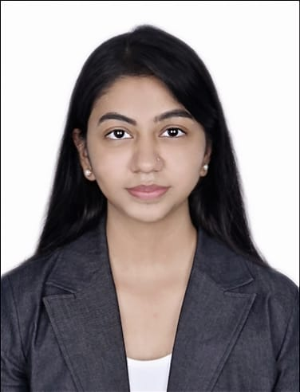

AI Powered Voice Anti-Spoofing Detection System
Team No. 32
Team lead, Akshaya Suryavanshi, AI-ML
Insert your professional photo
Symbiosis Institute Of Technology, Pune & Maharashtra
Chetanya Bhadravati, AI-ML

Slide 3
Problem Statement
AI Powered Voice Anti-Spoofing System
Voice authentication is widely used in banking, telecom, and customer support. However, modern AI tools can easily clone human voices and create realistic deepfake audio.
Current systems cannot reliably verify whether the voice is real or AI-generated. This creates serious risks of fraud, identity theft, and unauthorized access highlighting the urgent need for an intelligent voice anti-spoofing solution.

Slide 4
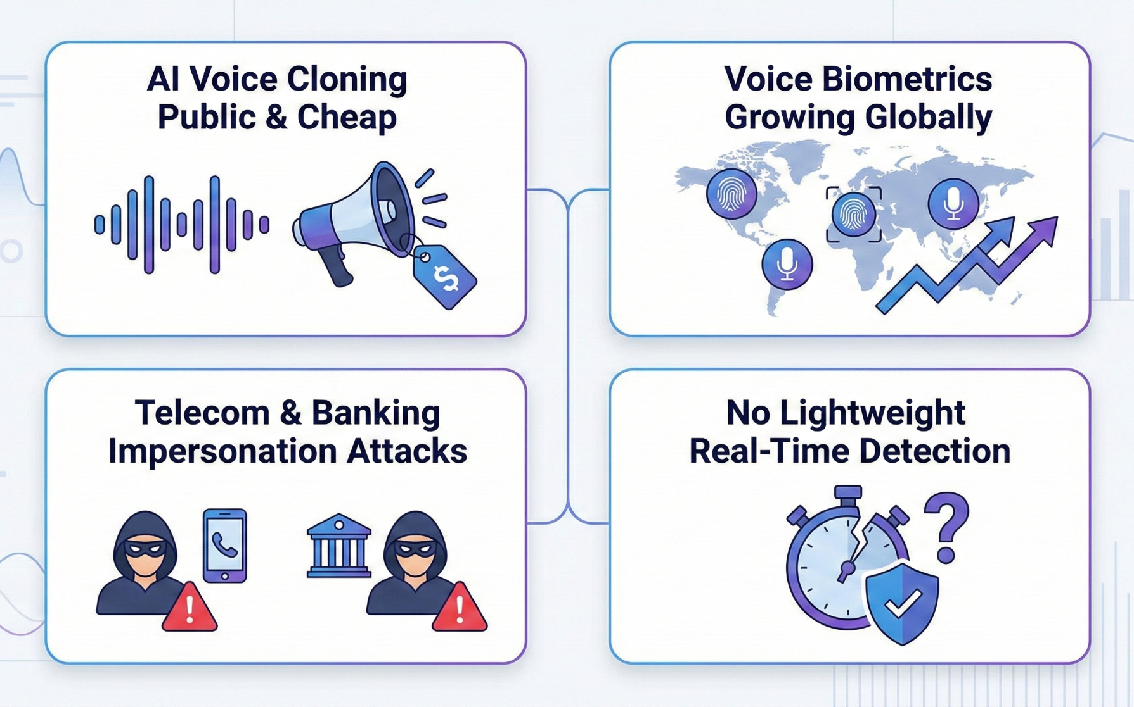
Need of Project

Slide 5

Proposed Solution
We propose an AI Powered Voice Anti-Spoofing System that automatically detects whether an audio sample is genuine or spoofed.

Slide 6
Solution Overview
Our solution follows an end-to-end AI pipeline:
Audio input is collected from users
Audio is converted into Mel-Spectrograms
Feature embeddings are extracted using a pre-trained model
An Artificial Neural Network classifies the voice
Output is displayed as
✅ REAL HUMAN VOICE or ❌ SYNTHETIC / CLONED VOICE

Slide 7
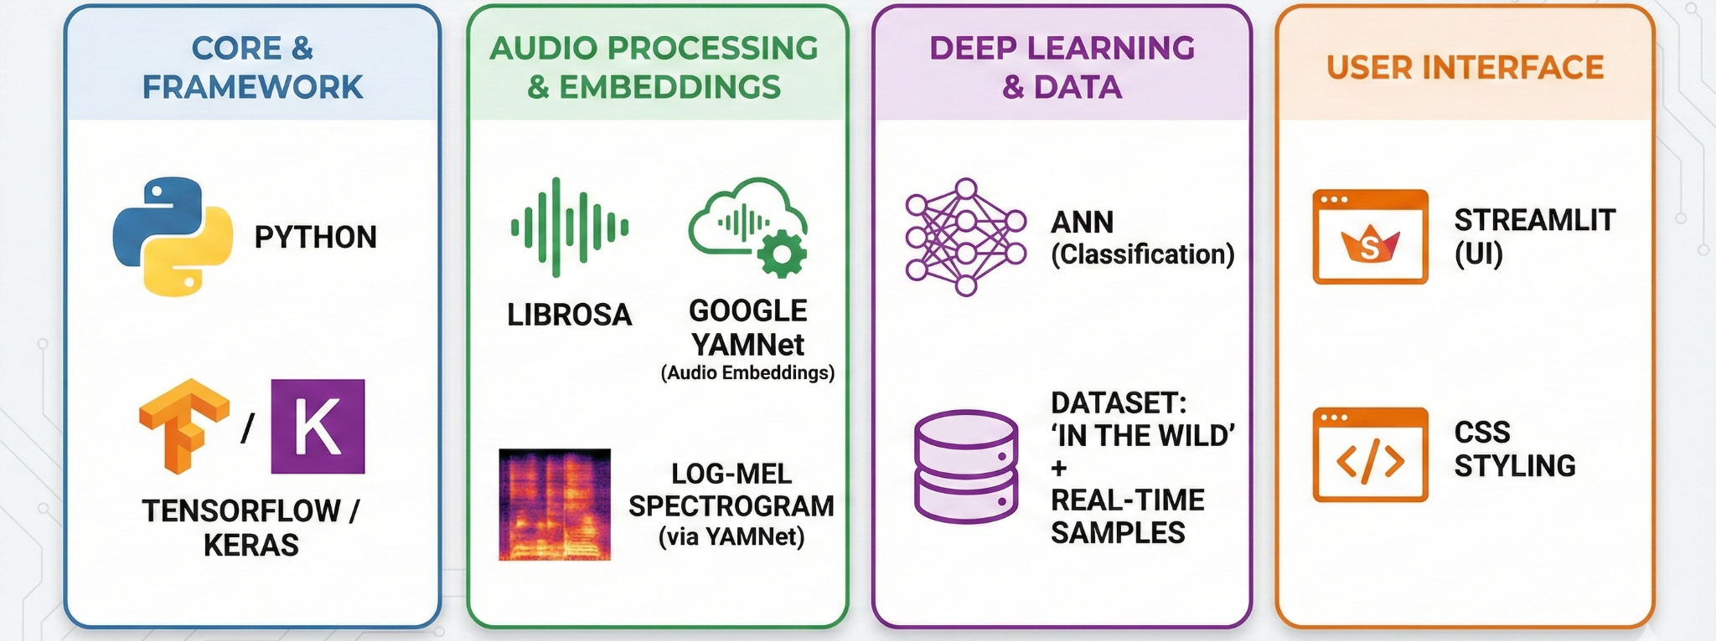
Technology used

Slide 8
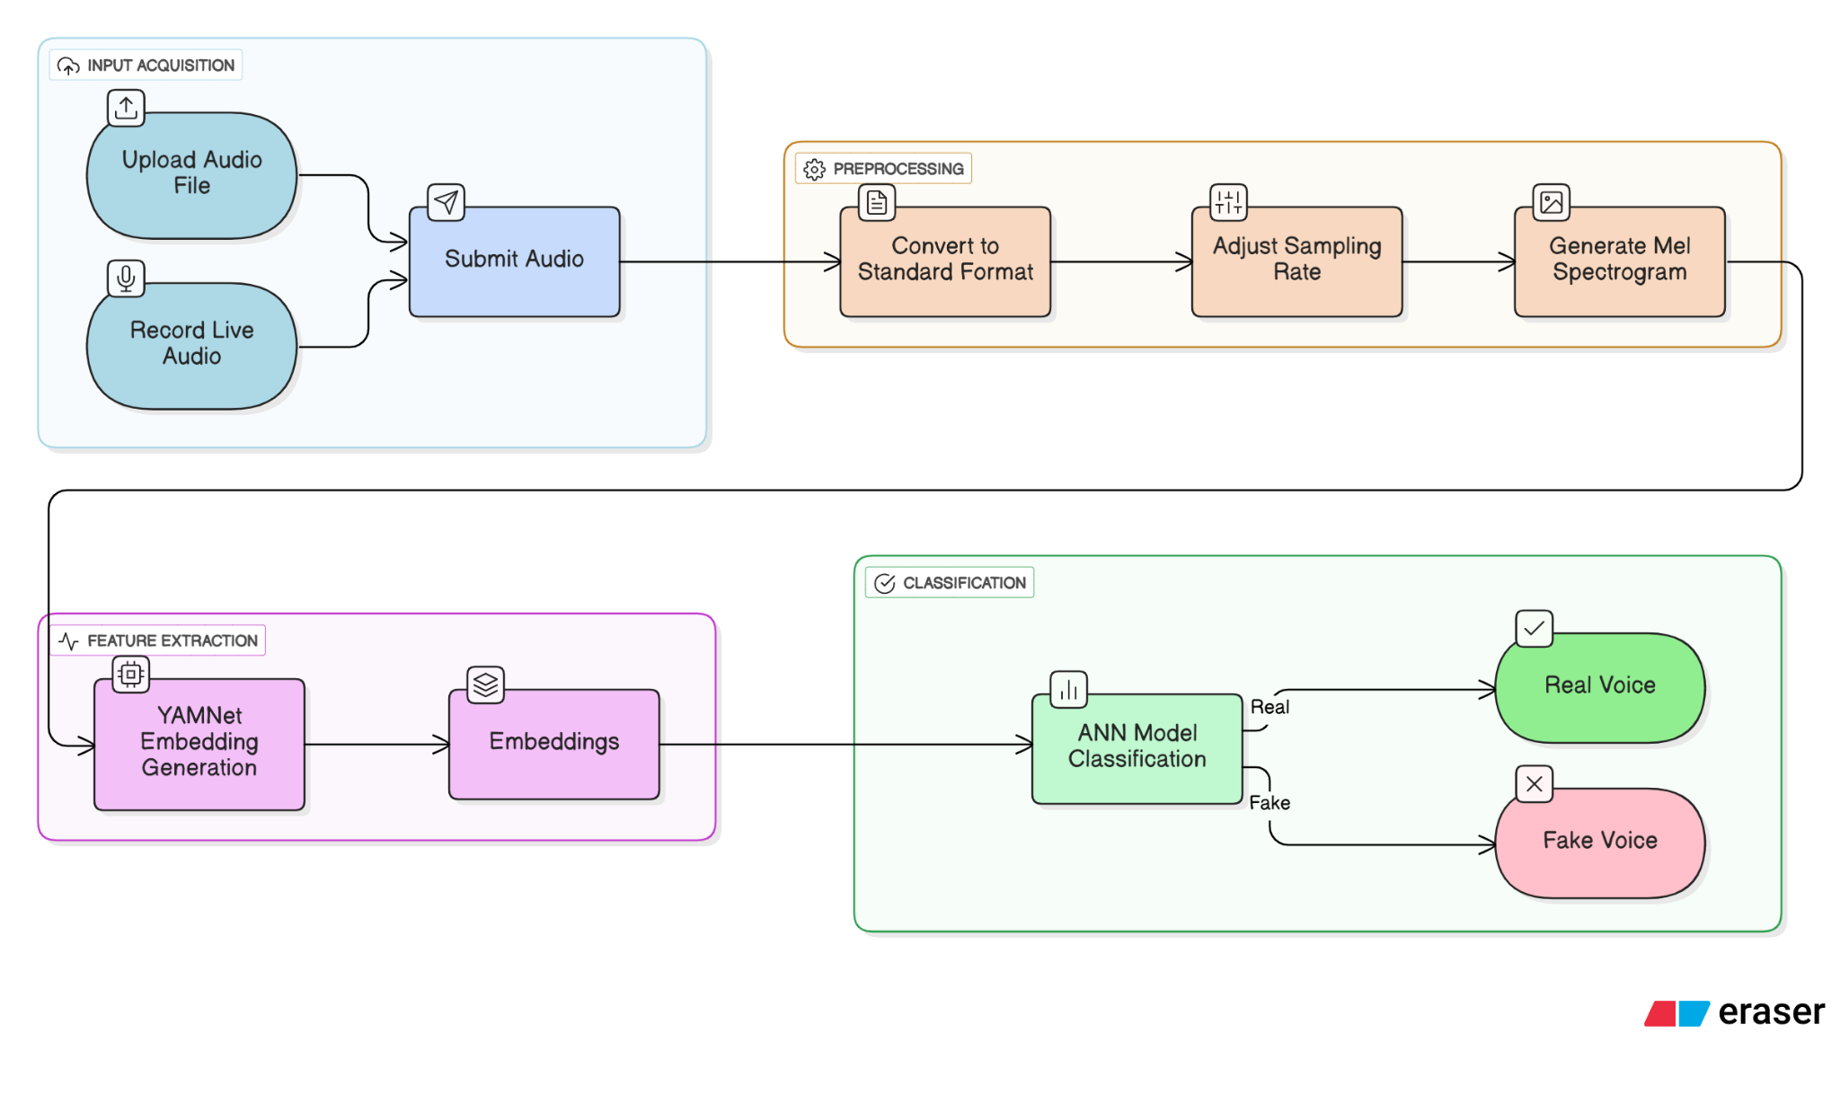
Technical flow diagram -

Slide 9
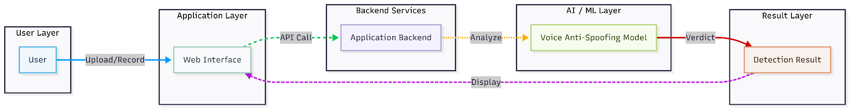
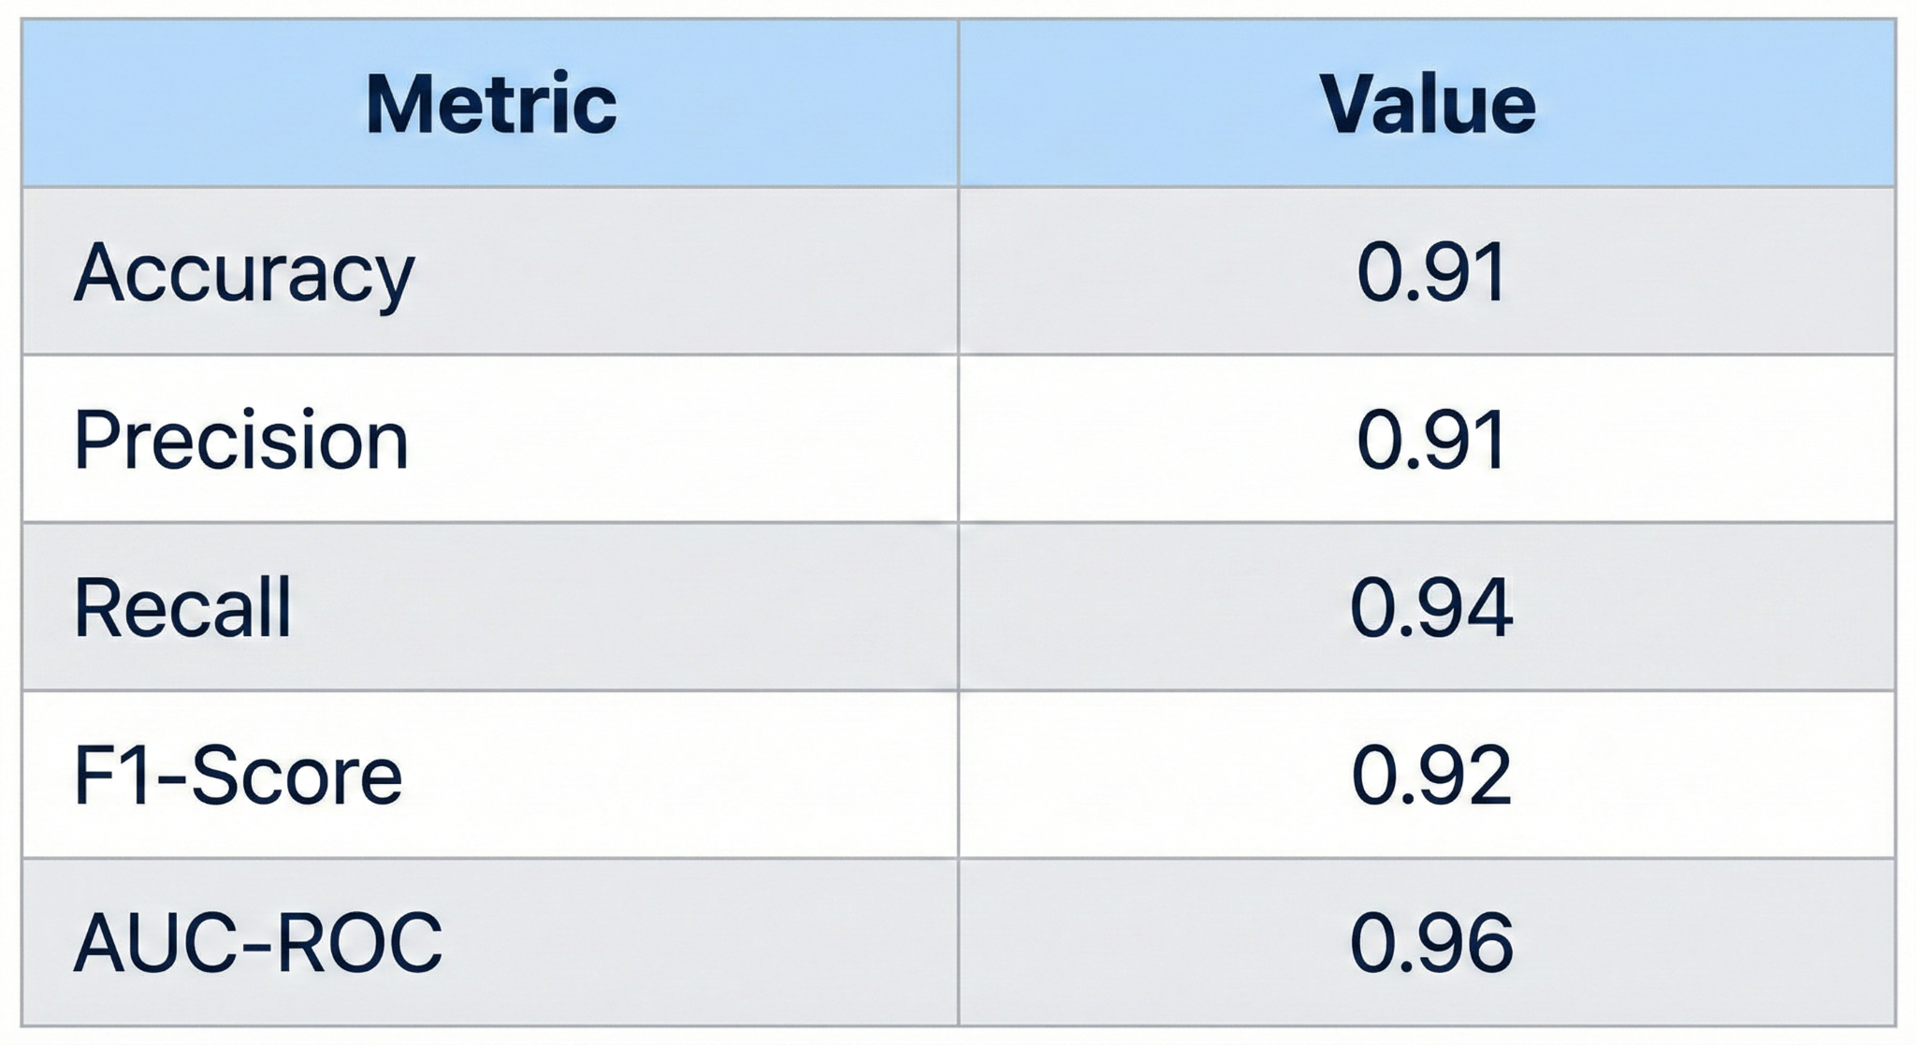
Architecture Blueprint

Slide 10
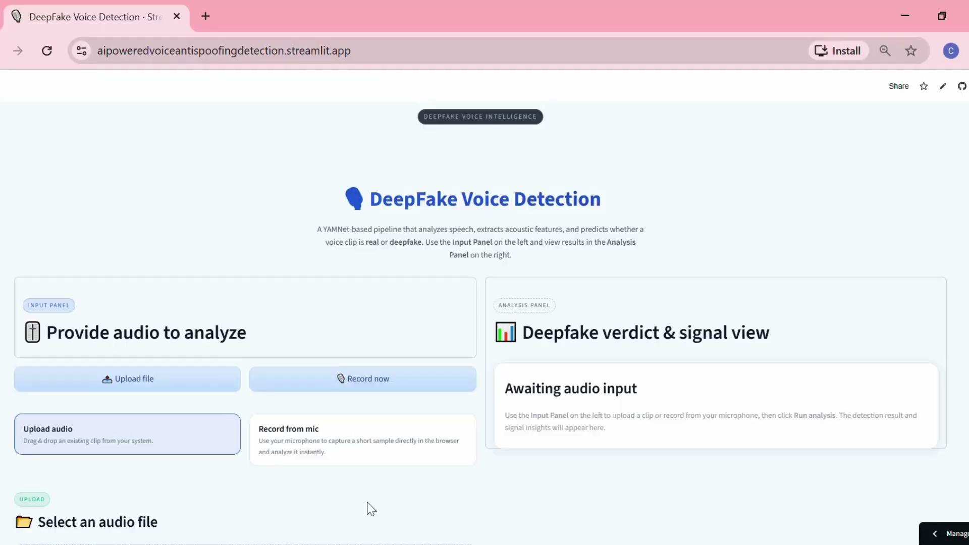
Demo Video
https://drive.google.com/file/d/1hOZ92EHhYwogN19nrspvKGAOFsMY5-ov/view?usp=sharing

Slide 11
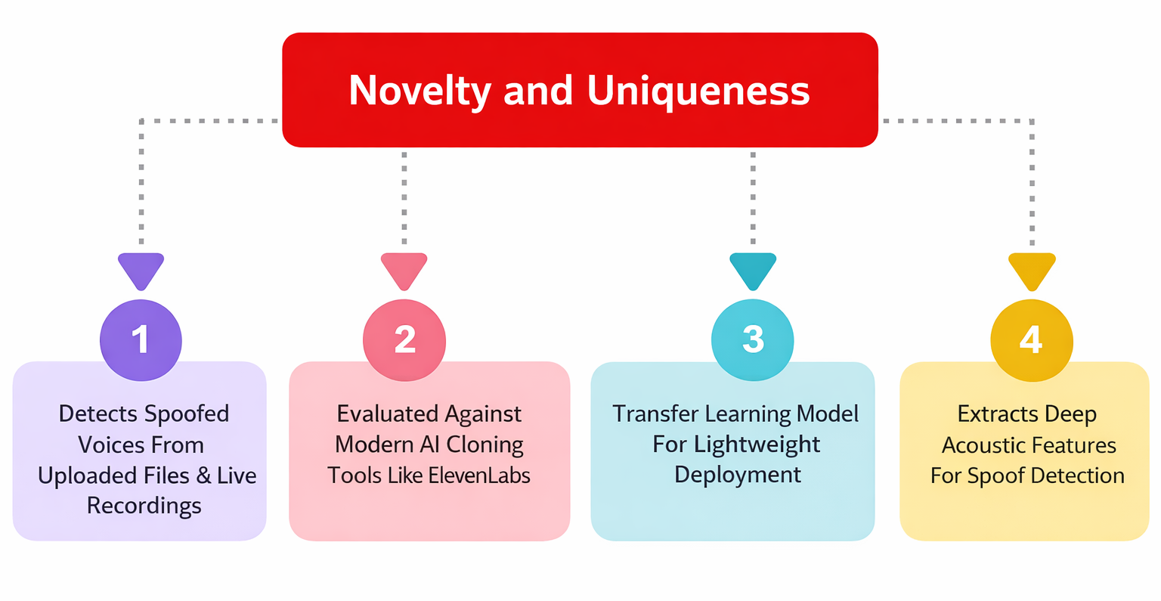

Slide 12
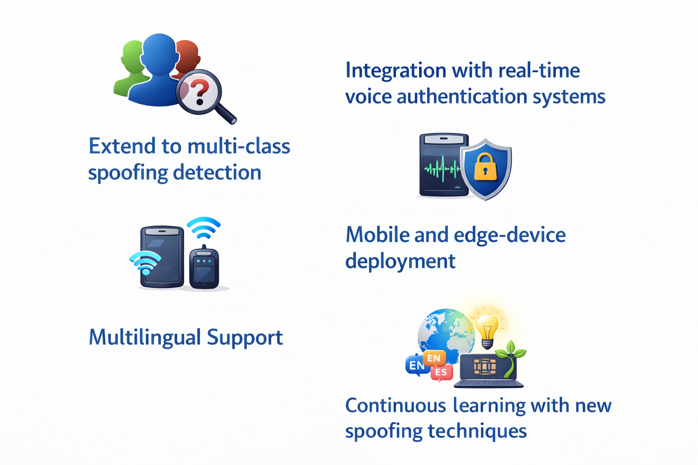
Future Scope

Slide 13
Git Hub Link
https://github.com/akshaya3107/AI_Powered_Voice_Antispoofing_Detection

Slide 14
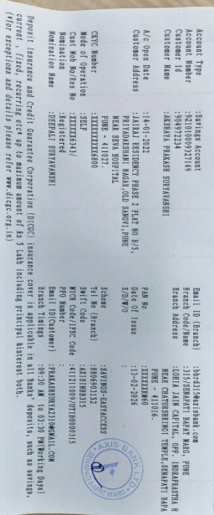
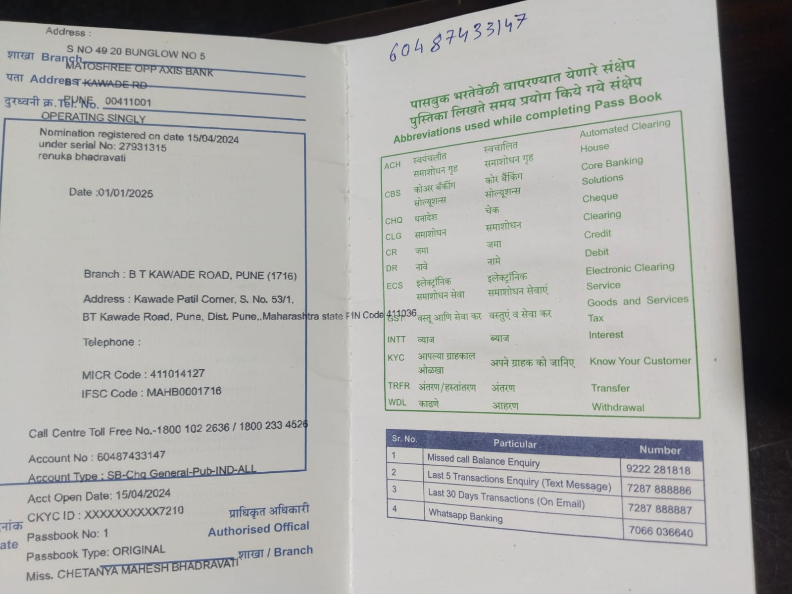
Bank Details
Full Name (as per bank records): | Bank Name | Branch Name | Account Number | Account Type (Savings / Current) | IFSC Code
Chetanya Mahesh Bhadravati | Bank of Maharashtra | B.T.Kawade Road | 60487433147 | Saving | MAHB0001718
Akshaya Prakash Suryavanshi | Axis Bank | S.B.Road | 921010009327149 | Saving | UTIB0000315
Chetanya Bhadravati
Akshaya Suryavanshi

Slide 15
Thank You

